Slide 1
MLB Baseball as a network
Marin Aske

Slide 2

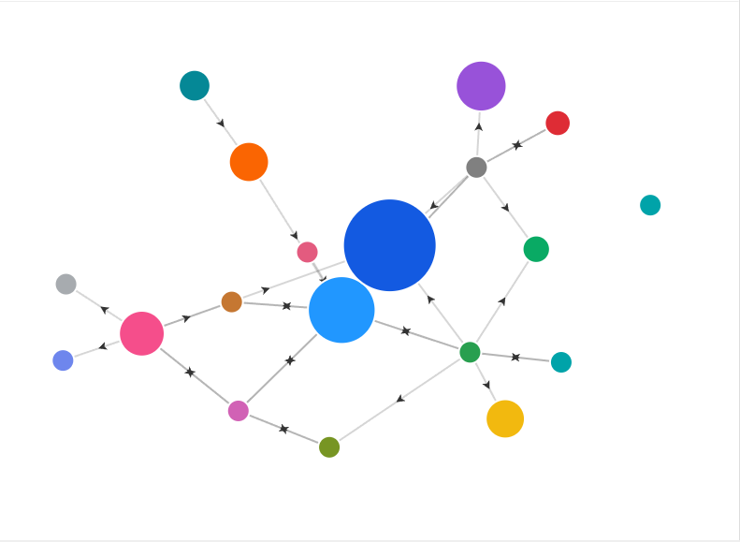
The network should look like this
There should be 30 nodes, with clusters and weighted connections based on the number of games the teams have played against each other this season. Teams that have played each other more in this past season will have darker lines and teams that share a division will be clustered together. There won’t be any outliers since every team should have a connection, either direct or transitory.

Slide 3

The singular connection that connects all nodes is based on the number of games that each team played against each other in the 2025 season.

Slide 4

Expectations
I expect there to be a good network that doesn’t just create a star. Obviously, there will be a good number of teams that are connected, but there will be some teams that have a bridge to connect them since some teams won’t play each other this year. There should be no outliers because each team should be connected, either directly or through a bridge/shared relationship with another team.

